Slide 1
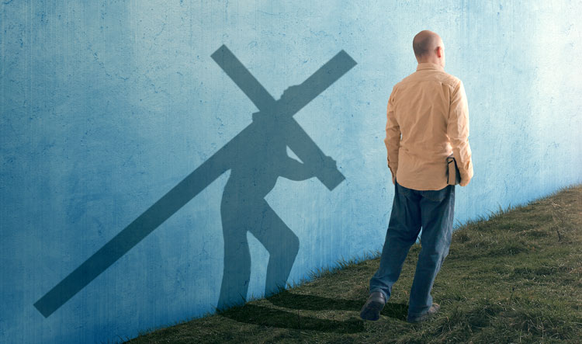
Be Discipled
Mark
Dr. Rick Griffith • Crossroads International Church Singapore
BibleStudyDownloads.org

Slide 2
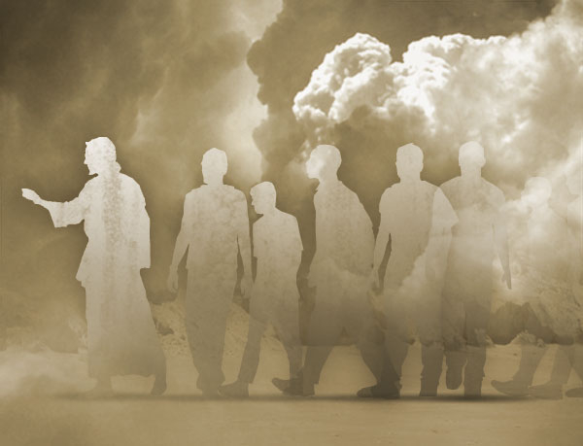
Disciple = Follower

Slide 3
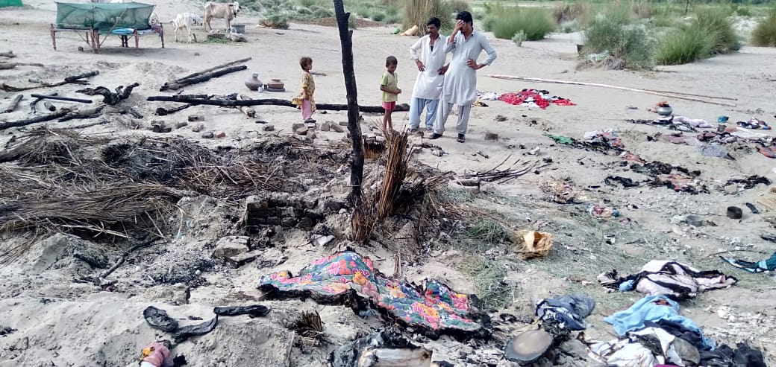
Pakistan
Notes:
One of my former Pakistani students sent this 21 August 2019 email:
Unjustly Enduring Persecution is an Act of Grace! Jesus Demonstrated it & His Followers are Called for It!
My heart is deeply saddened as I report that yet another newly converted Hindu family has been severely persecuted for their decision to follow Christ. Non-stop persecution of Christians and Hindus is an every day thing who face persecution at the hands of majority religion. This incident took place in Village 36, Sanghar District, Sindh, one of our ministry areas.
The wood and straw hut of the family was set on fire by an angry mob of close to 100 people. The fire destroyed everything they had including money that they got from selling their livestock only a few days before the incident. All of their belongings have been burnt. They don't even have utensils to eat in. First Investigation Report has been registered at the local police station. The incident was reported in five local Sindhi newspaper. The name of the head of the persecuted family is brother Abdul Masih. Pastor Bhooro and Pastor Girdhari, our team members reported this matter to me. A temporary shelter, some clothing, bedding, utensils and a few other things have been provided to the family for survival. But prayers are needed for the protection of the family and finances to help them with a new hut/house, all the household stuff, money to buy to buy livestock which is the main source of survival and income. Please stand with us to pray for this family that the Lord will protect them and others who turn to Christ.
Blessings
Naeem

Slide 4
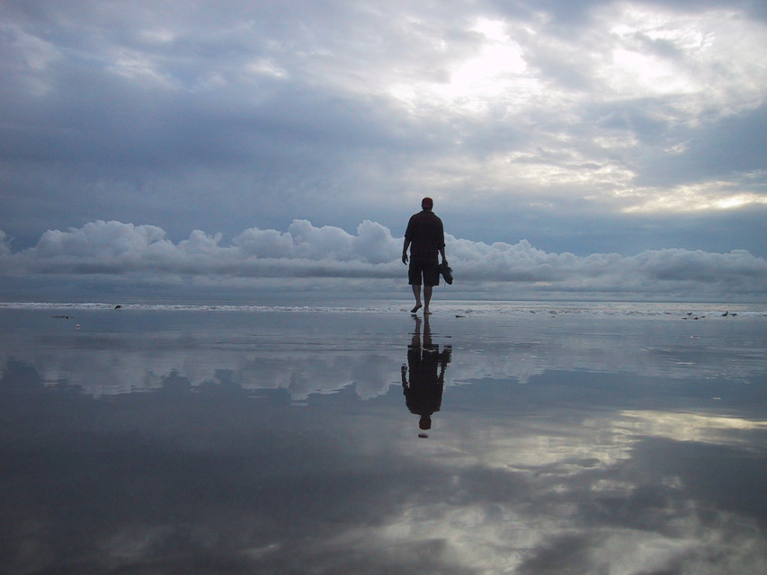
Disciple.
Notes:
Most of us haven’t had our house burnt down, but we may know something about the cost of being a disciple. For me, it started at age 13 when I was the first in my family to trust Christ. We lived in the second wealthiest part of town with a nice house. We had a vacation cabin, 7 cars, 2 boats—and we were miserable. To honor my parents, I agreed to major in business in university, but God got ahold of my heart. Two hours after my graduation, I left home to become a missionary. I remember my mother saying in desperation, “I can’t believe my son would graduate with honors from business school and go beg for money!”
My parents left my choice of profession up to me, but my church felt that I should go into business—so when I came to Asia, my church refused to support me and asked the members not to do so also. I never felt so alone. Is this what it means to be a disciple—a follower of Jesus?

Slide 5
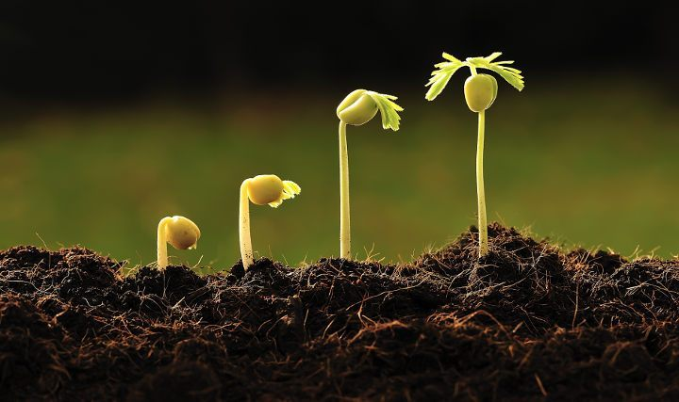
What’s your strategy to follow Jesus?
Notes:
My guess is that being a disciple isn’t easy for you either.
Salmon swim upstream, and followers of Jesus go against the current also.
This is why the Canadian college accrediting agency will not accredit Trinity Western University Law School unless they approve of homosexuality—thus no more conservative lawyers getting trained in Canada!
The Virginia Real Estate Board also recently filed a complaint against a Christian realtor who had Bible verses on her website.
How will you stay faithful as a disciple (follower) of Christ? How are you going to continue to grow?

Slide 6
How can you be a true disciple of Jesus in a hostile world?
Notes:
What’s it gonna take to really follow Christ when most people around you oppose Jesus?

Slide 7
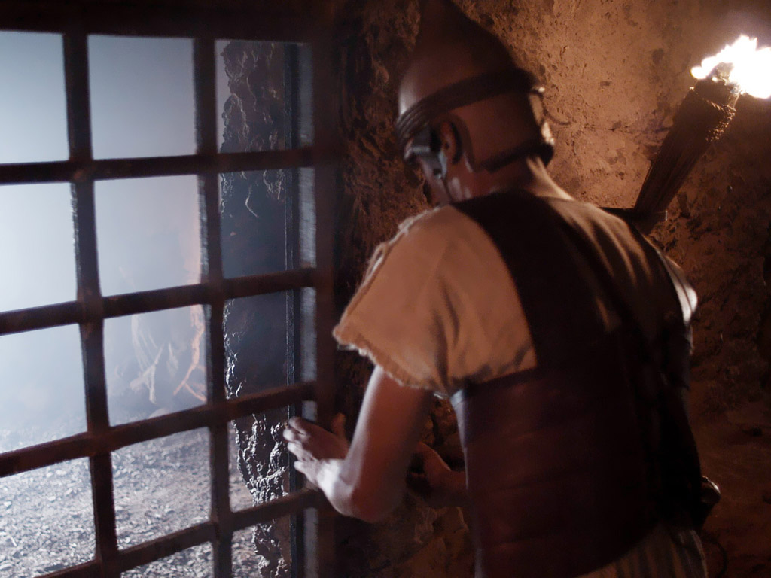
What would you do if this church was under persecution, some being fed to lions, many going underground, all fearful?
Mark wrote an account of the suffering of Jesus to encourage his people!

Slide 8
NT Overview (History)
38 124 39-41
"To the remotest part of the earth" (Acts 1:8)
Acts 9 13 14 15 16 18 21 27 28
Apr 48- Sep 49
1 Galatia
Apr 50- Sep 52
2 Aegean
Spr 53- May 57
3 Asia
Feb 60- Mar 62
1 Rome
Spr 62- Fall 67
4 Spain
Aut 67- Spr 68
2 Rome
Summer 35- 37
Damascus Antioch
May 57- Aug 59
Trials
Fall 49
The
Council
Spring 68
Expansion of Church
35 48 49 50 52 53 57 60 62 67 68 95
Matt
Luke
Acts
Mark
Gospels & Acts
1234
Journeys
Rome
Imprisonments
Gospels & Acts

Slide 9
Date of Mark
83
Peter did not come to Rome until about AD 63 – Mark's gospel cannot be dated before AD 63.
Mark does not mention the Fall of Jerusalem in AD 70 – Mark was probably penned between AD 64-68, during the reign of Nero.
Peter was martyred in AD 64, but tradition divides whether Mark composed before Peter's death or afterwards
63 Peter at Rome
64 Peter Dies
68 Nero Dies
70
Temple Destroyed

Slide 10
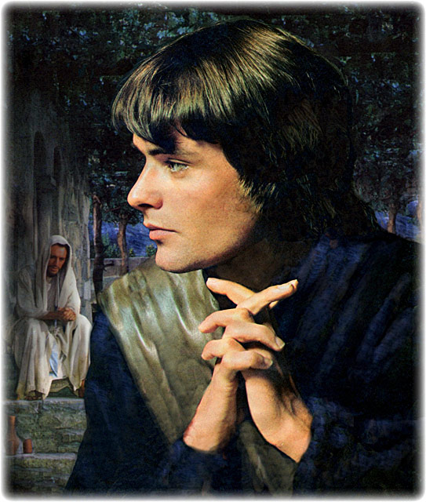
Who was Mark?
89b-f
Got an "F" at wealthy home (Acts 12:12-18)
Got an "F" at Jesus' Gethsemane arrest (Mark 14:51)
Got an "F" on first mission trip with Paul (Acts 13:13)
Got an "F" on team unity (Acts 15:36-41)
Got a "A" when wrote his gospel under Peter at Rome
"Useful for ministry" (2 Tim. 4:11)
Notes:
Mark was the right man to write on discipleship, given his many failures that he had to overcome.

Slide 11
How can you be a true disciple of Jesus in a hostile world?
Notes:
What’s it gonna take to really follow Christ when most people around you oppose Jesus?

Slide 12
How to Be a Disciple in a Hostile World
Not to Do
To Do
To Do
Result
1:1-13 | 1:14–10:52 | 11–15 | 16
Notes:
To learn how to be true disciples today, we will see what not to do, what to do (two things), and the result.
First, what is the thing not to do?

Slide 13
How to Be a Disciple in a Hostile World
Don’t cling to your Authority
1:1-13 | 1:14–10:52 | 11–15 | 16
Mark
Notes:
Imitate the humility of the Suffering Servant despite being God and Messiah (1:1-13).

Slide 14
Slides on Mark 1

Slide 15
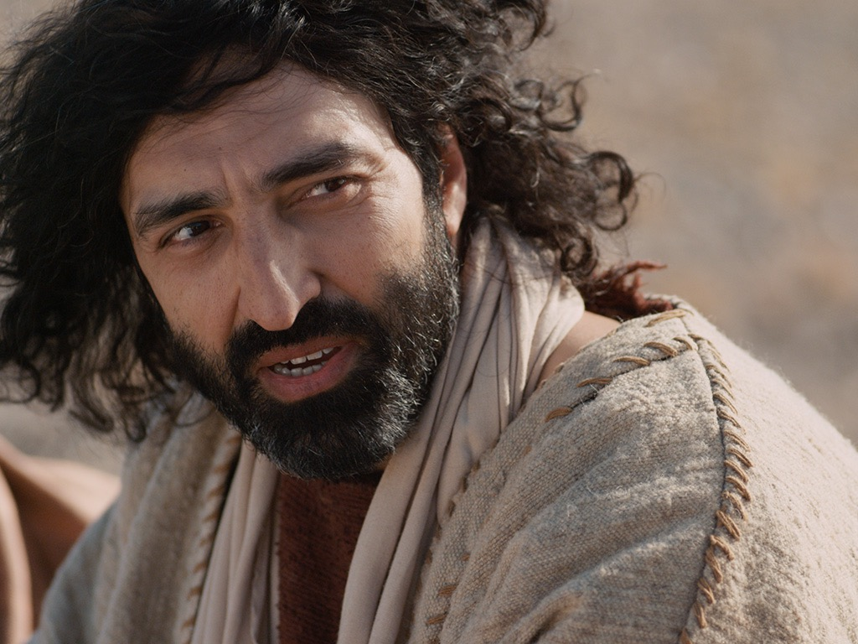
"This is the Good News about Jesus the Messiah, the Son of God" (Mark 1:1 NLT).
Notes:
Jesus is the Ultimate Authority—Israel’s king and God himself (1:1).

Slide 16
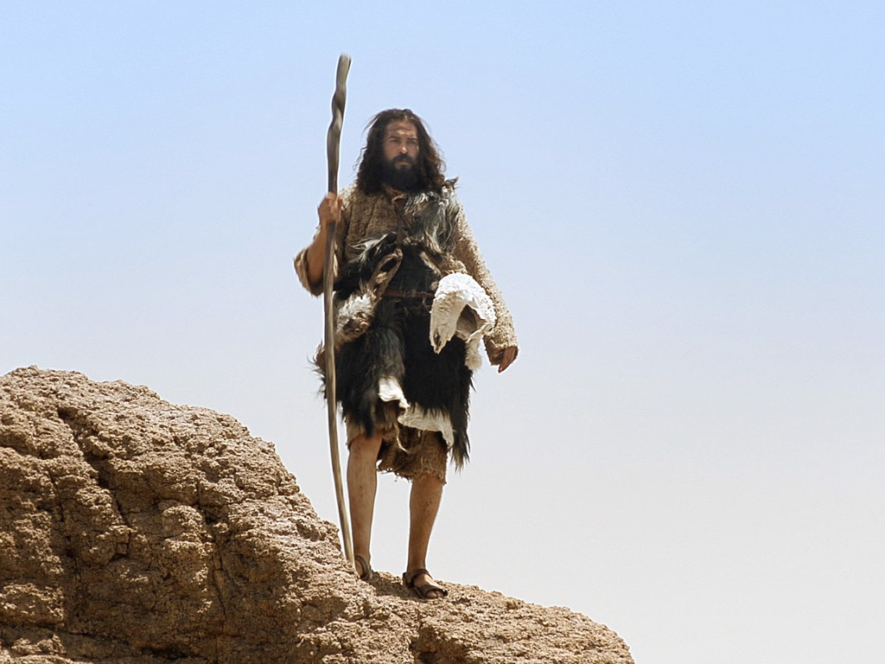

Slide 17
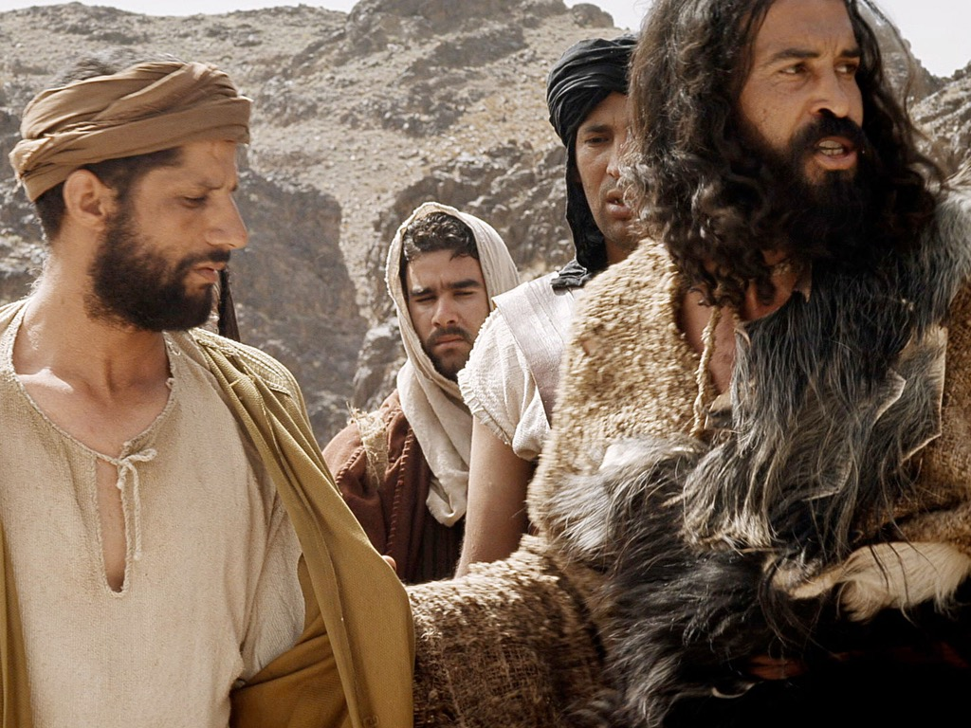
"John announced: ‘Someone is coming soon who is greater than I am—so much greater that I’m not even worthy to stoop down like a slave and untie the straps of his sandals’" (Mark 1:7 NLT).
Notes:
John served humbly since he saw Jesus as the Greatest man ever (1:2-8).

Slide 18
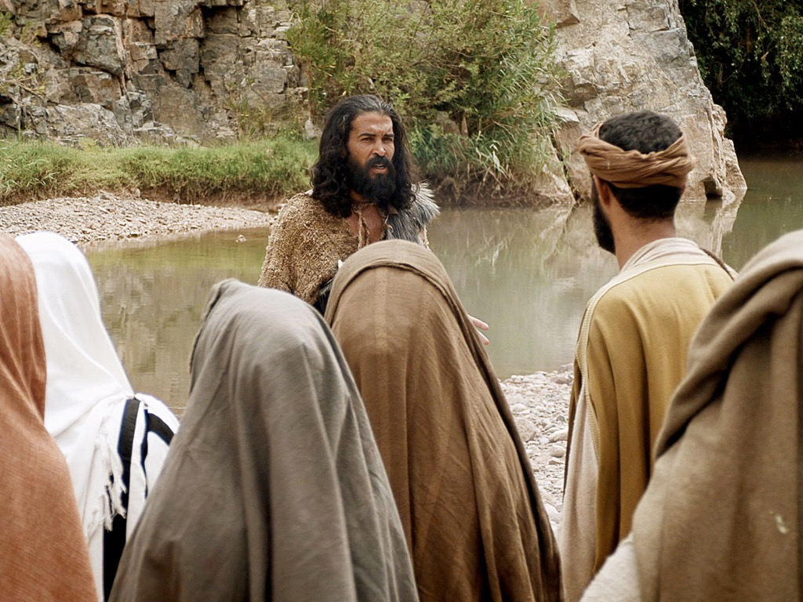
"I baptize you with water, but he will baptize you with the Holy Spirit!" (Mark 1:8 NLT).
Notes:
John served humbly since he saw Jesus as the Greatest man ever (1:2-8).

Slide 19
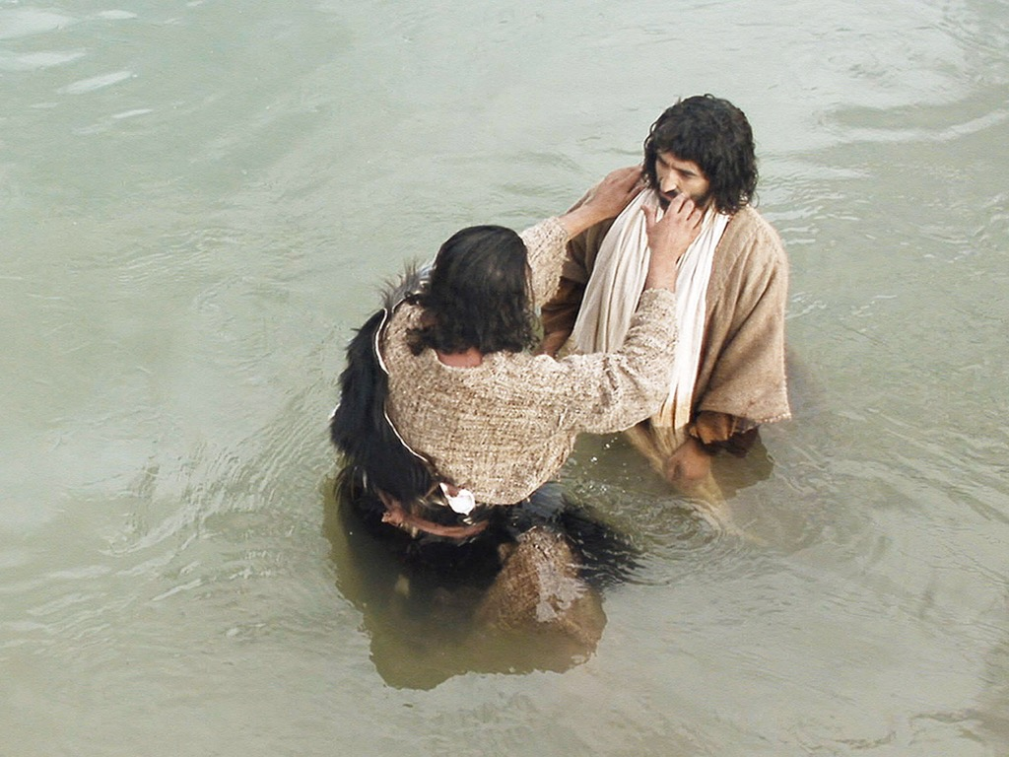

Slide 20
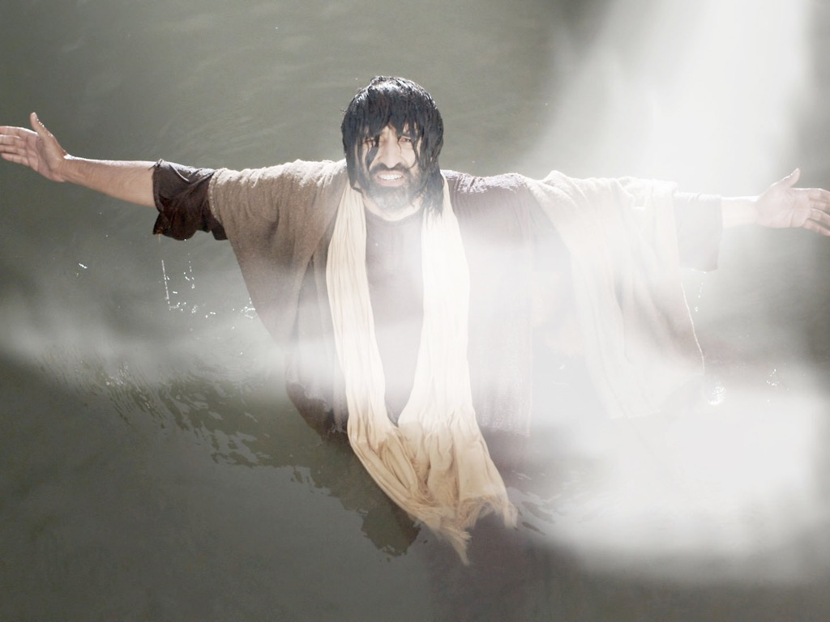
"And a voice from heaven said, ‘You are my dearly loved Son, and you bring me great joy’” (Mark 1:11 NLT).
Notes:
Jesus was praised by God himself at his baptism (1:9-11).

Slide 21
THE WORD IN PICTURES
Free Bible images

Slide 22
Used with Permission
"The Spirit then compelled Jesus to go into the wilderness, ¹³where he was tempted by Satan for forty days. He was out among the wild animals, and angels took care of him"
(Mark 1:12-13 NLT).
THE GOSPEL ——OF—— MATTHEW
THE GOSPEL ——OF—— MARK
THE GOSPEL ——OF—— LUKE
THE GOSPEL ——OF—— JOHN
Due to the Lumo Project producing its own publishing material we regret to inform you that we cannot license our photos to other clients outside of freebibleimages.org.
These images are not licensed for reuse in video, epublishing or other media. Downloaded pictures and files cannot be redistributed through any other website than freebibleimages.org. or used in any context where the accompanying message is undermining of the Christian faith and gospel.
Photos can only be used on educational presentations, blogs and social media, all of which should be accompanied with reference to www.LumoProject.org.
Picture courtesy of BBM © All Rights Reserved.
www.bigbookmedia.com
Notes:
Jesus was cared for by angels at his temptation (1:12-13).

Slide 23
Jesus is the main attraction, so we’re not big on our own authority here.

Slide 24
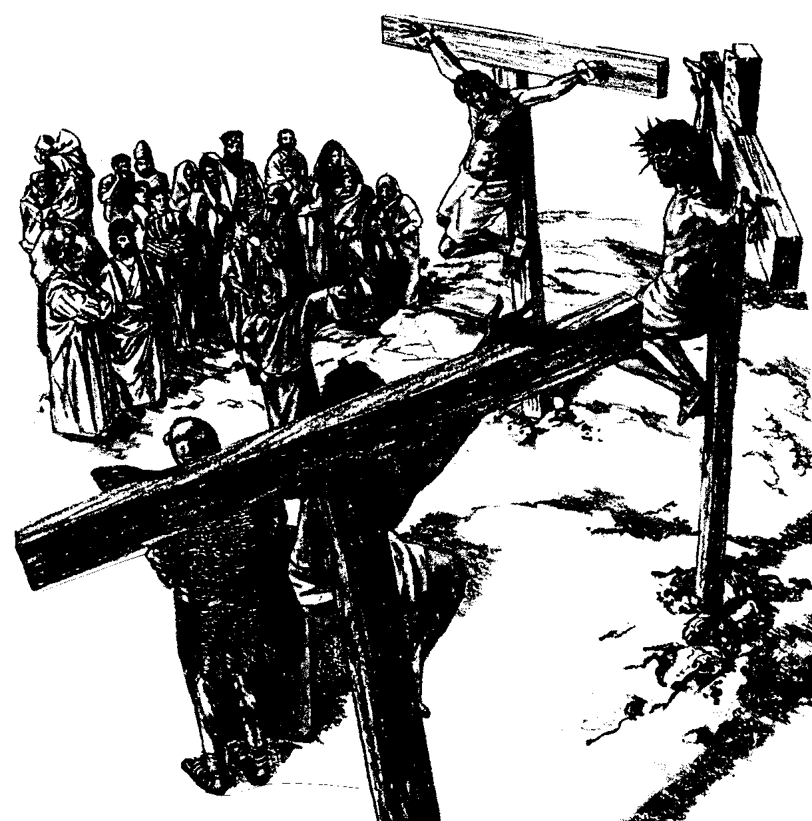
The Paradox of Authority and Servanthood in Mark
 | Authority | Servanthood
Themes | Christ's Leadership | Discipleship
Strategy | Gentiles lord it over others (10:42) | Disciples serve (10:43)
Motivation | "Save his life" (8:35a) | "Lose his life" (8:35b)
Priority | "First" (9:35a; 10:31a) | "Last" (9:35b; 10:31b)
Reputation | "Great" (10:43a) | "Servant" (10:43b)
Position | "First" (10:44a) | "Slave of all" (10:44b)
Authority Examples | Authority without Serving: • Religious leaders • Rich man • Judas | Authority & Served: • John the Baptist • Joseph of Arimathea
Servanthood Examples | Authority but Struggled to Serve: • Disciples | No Authority & Served • Bartimaeus • Woman who anointed Jesus
1st Section (1:1–8:26) | Authority of Christ
2nd Section (8:27–10:52) | Authority- Servanthood Tension
3rd Section (11–16) |  | Servanthood of Christ
89a
Summary of Narry F. Santos, Bibliotheca Sacra 154 (Oct.-Dec. 1997): 452-60

Slide 25
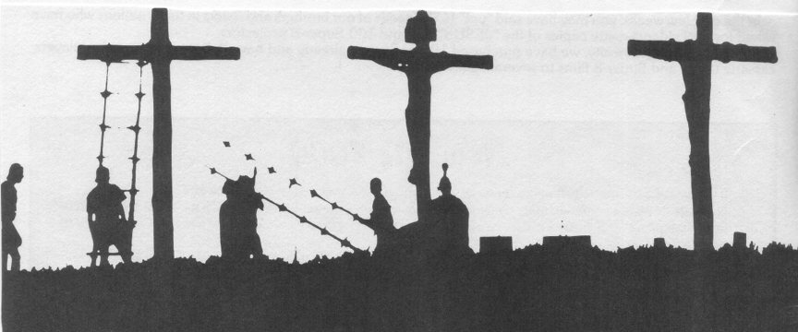
Worldly Leadership
Mark
89a
Worldly Leadership
Followers serve the leader, who is at the top
Leader
Followers

Slide 26
Biblical Leadership
Mark
89a
Biblical Leadership
The leader serves the followers
Followers
Leader

Slide 27
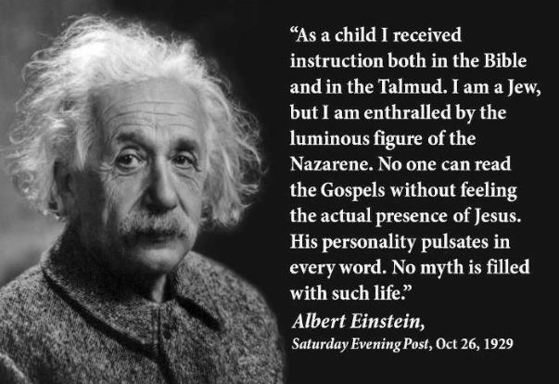
Albert Einstein on Jesus
"As a child I received instruction both in the Bible and in the Talmud. I am a Jew, but I am enthralled by the luminous figure of the Nazarene. No one can read the Gospels without feeling the actual presence of Jesus. His personality pulsates in every word. No myth is filled with such life."
Albert Einstein Saturday Evening Post, Oct 26, 1929

Slide 28
Theme
23
Deity Who Models Suffering as Servant
Mark

Slide 29
Mark Book Chart
82
Deity Who Models Suffering As Servant
Service |  | Suffering
Sayings and Signs |  | Sacrifice
Galilee & Perea |  | Judea & Jerusalem
Coming | Ministry Opposition | Self- Sacrifice | Resurrection
1:1-13 | 1:14–10:52 | 11–15 | 16
Key Verse
"For even the Son of Man
did not come to be served,
but to serve, and to give his life
as a ransom for many"
(Mark 10:45).
serve
give his life

Slide 30
How can you be a true disciple of Jesus in a hostile world?
Notes:
What’s it gonna take to really follow Christ when most people around you oppose Jesus?

Slide 31
How to Be a Disciple in a Hostile World
Don’t cling to your Authority
Serve
like Jesus
1:1-13 | 1:14–10:52 | 11–15 | 16
Mark
Notes:
Help others despite opposition, which Jesus lived and taught (Mark 1:14–10:52).

Slide 32
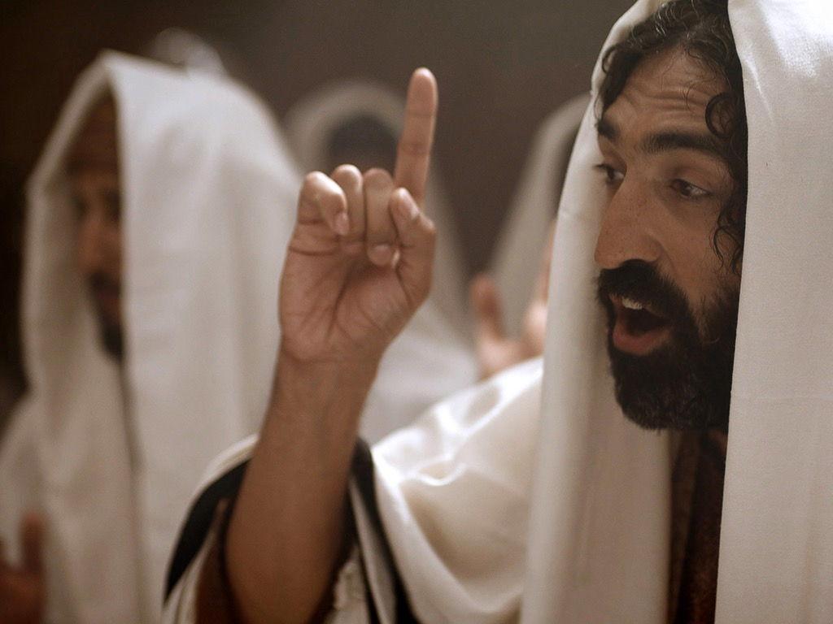
"The time promised by God has come at last!” he announced. “The Kingdom of God is near! Repent of your sins and believe the Good News!" (Mark 1:15 NLT).
Notes:
Jesus cared for people by announcing the kingdom that freed them from sin through repentance (1:14-15).

Slide 33
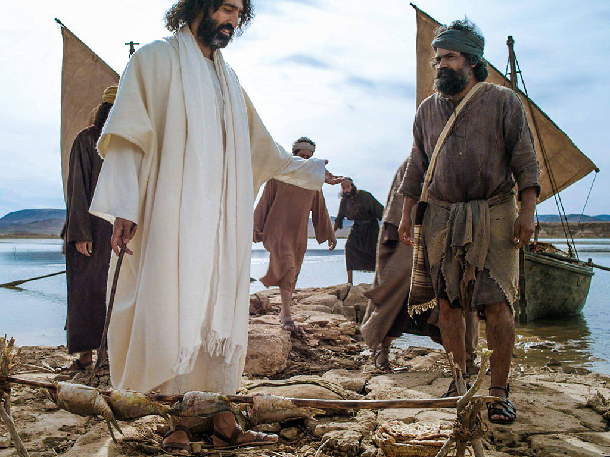
"Jesus called out to them, ‘Come, follow me, and I will show you how to fish for people!’ ¹⁸ And they left their nets at once and followed him" (Mark 1:17-18 NLT).
Notes:
Jesus cared for people by calling disciples to a purposeful life (1:16-20).

Slide 34
Slides on Mark 2

Slide 35
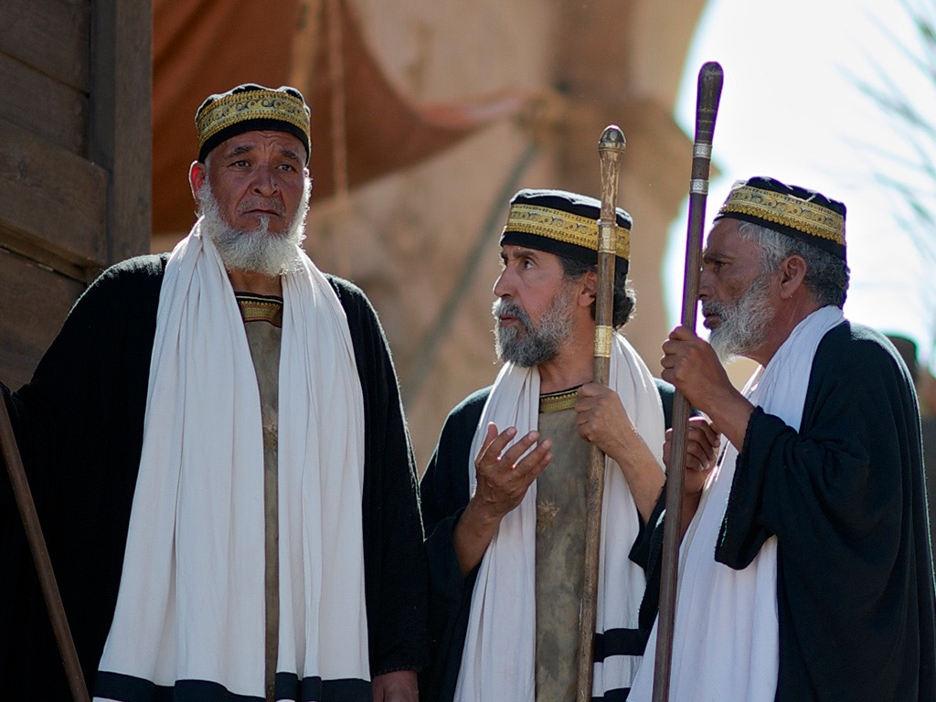

Slide 36
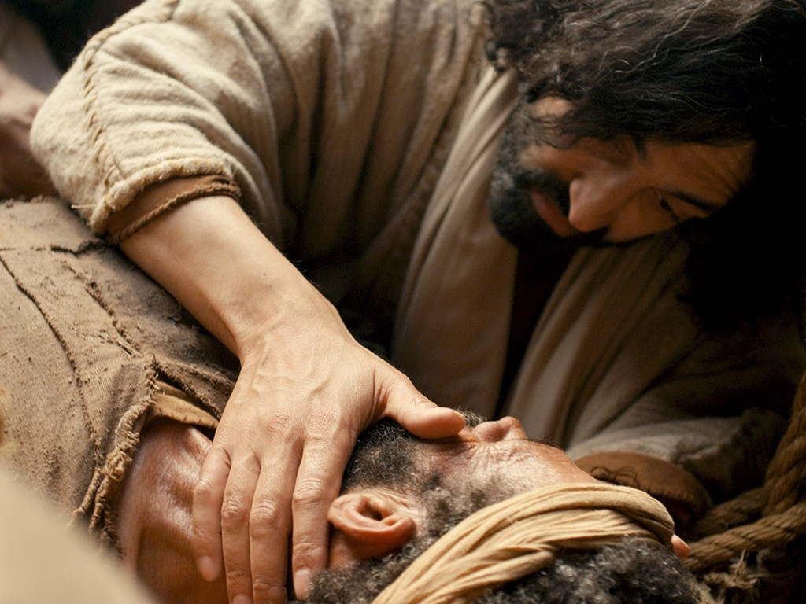
"So I will prove to you that the Son of Man has the authority on earth to forgive sins.” Then Jesus turned to the paralyzed man and said, ¹¹“Stand up, pick up your mat, and go home!" (Mark 2:10-11 NLT).
Notes:
Jesus used his authority by healing an oppressed leper and paralytic to show his followers servant care for others (1:40–2:12).

Slide 37
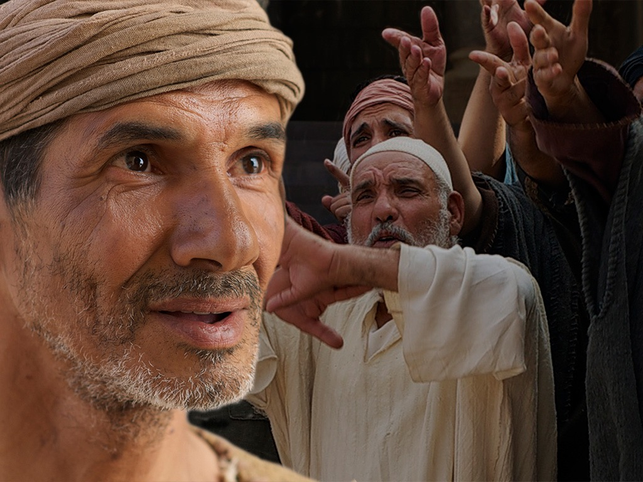

Slide 38
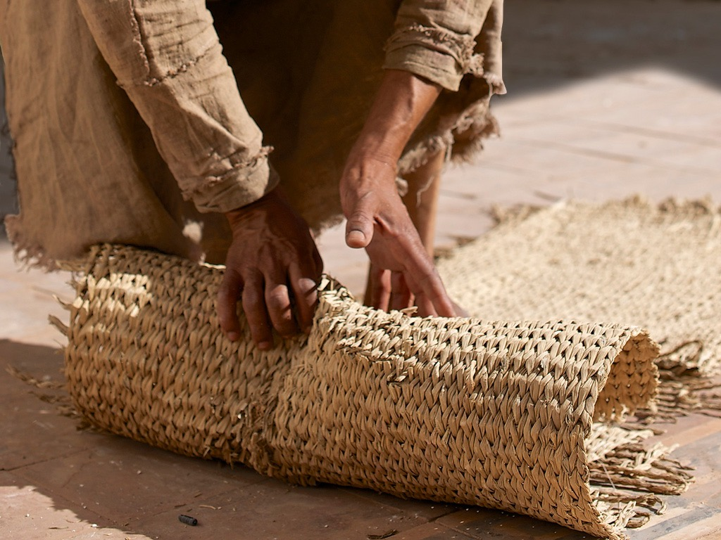

Slide 39
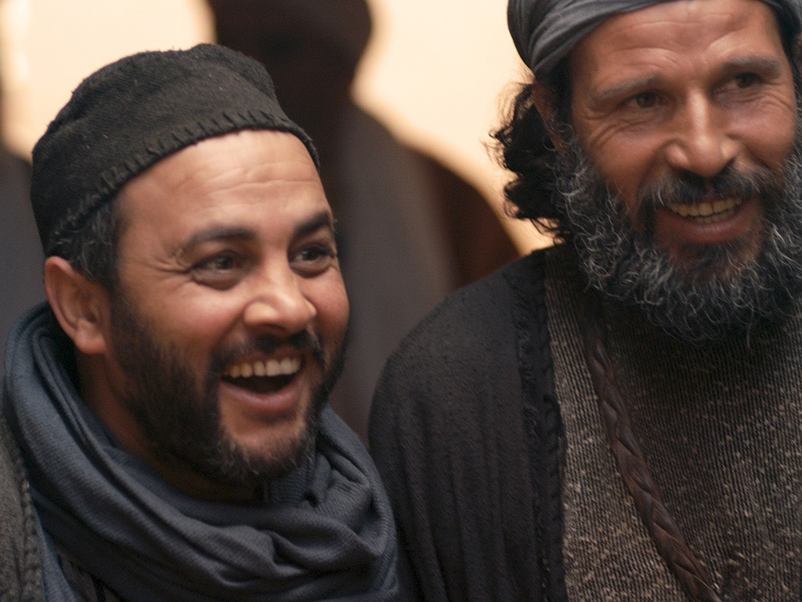

Slide 40
Mark Book Chart
82
Deity Who Models Suffering As Servant
Service |  | Suffering
Sayings and Signs |  | Sacrifice
Galilee & Perea |  | Judea & Jerusalem
Coming | Ministry Opposition | Self- Sacrifice | Resurrection
1:1-13 | 1:14–10:52 | 11–15 | 16
Many opposed Jesus as Servant—so we also will be opposed (2:13–8:26).

Slide 41
Slides on Mark 3

Slide 42
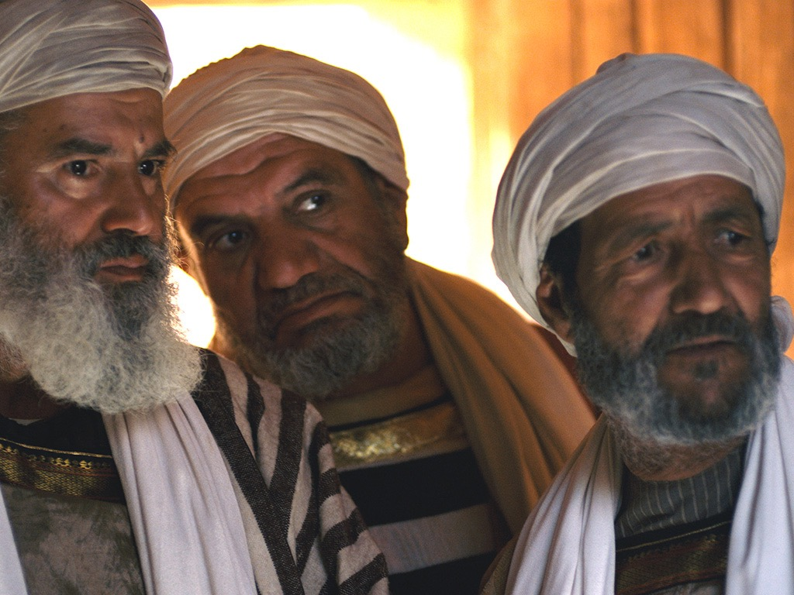
"Jesus went into the synagogue again and noticed a man with a deformed hand.
² Since it was the Sabbath, Jesus’ enemies watched him closely. If he healed the man’s hand, they planned to accuse him of working on the Sabbath" (Mark 3:1-2 NLT).
Notes:
Jewish religious leaders initially opposed Jesus over various issues (2:13–3:35).

Slide 43
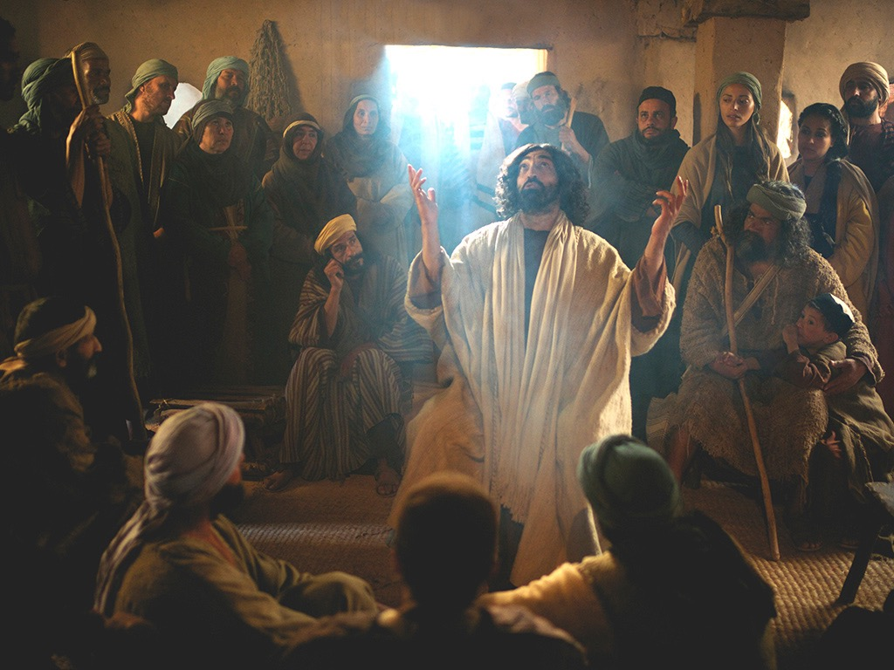
Mark 3:20-21 NLT
One time Jesus entered a house, and the crowds began to gather again. Soon he and his disciples couldn’t even find time to eat. ²¹When his family heard what was happening, they tried to take him away. “He’s out of his mind,” they said.

Slide 44
Slides on Mark 4

Slide 45
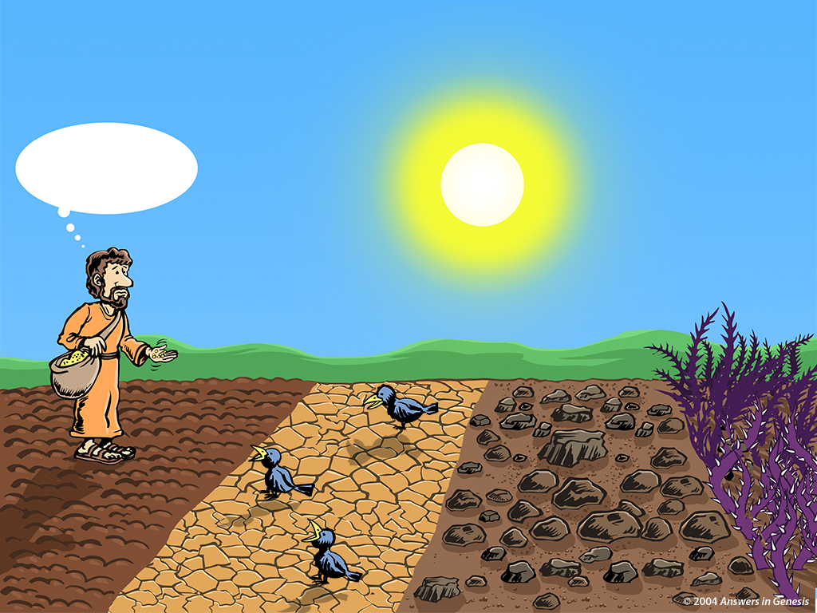
Know Your Soil 00899
Sowers, Know Your Soil!
I know where these seeds won't grow!
Thorny Soil
Good Soil
Hard Soil
Rocky Soil
Notes:
Christ responded to the opposition with parables about the stagnant state of those rejecting him in contrast to the growth of his kingdom (4:1-34).
CR-09-Creation Evangelism-64

Slide 46
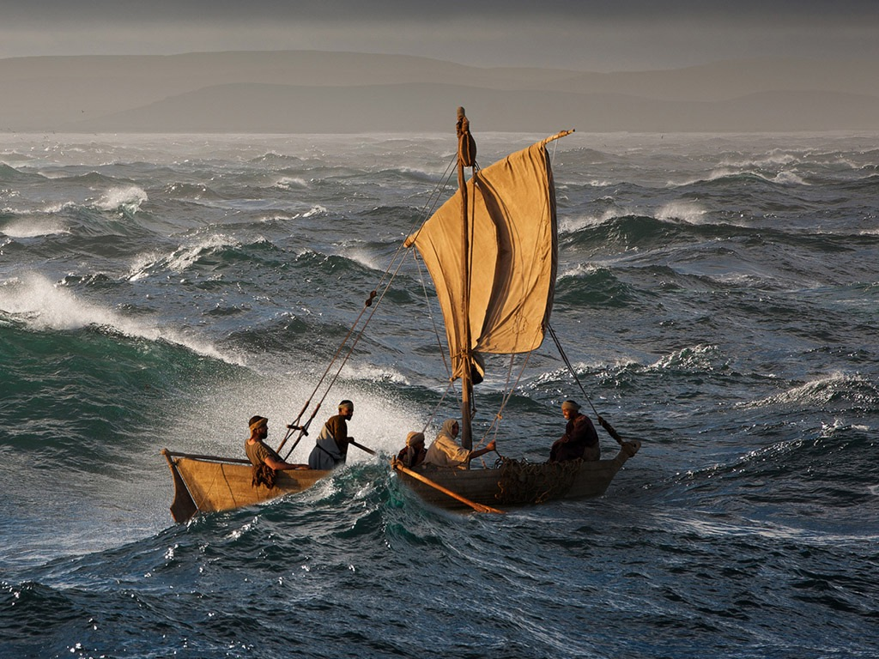
Free Bible images
Matthew 8:23-27
Mark 4:35-41 Luke 8:22-25
JESUS CALMS A STORM

Slide 47
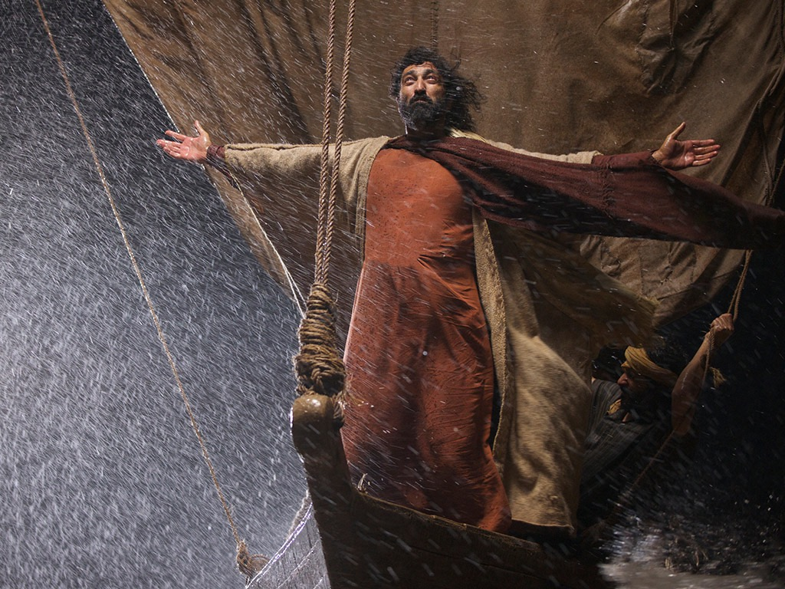
"When Jesus woke up, he rebuked the wind and said to the waves, ‘Silence! Be still!’ Suddenly the wind stopped, and there was a great calm" (Mark 4:39 NLT).

Slide 48
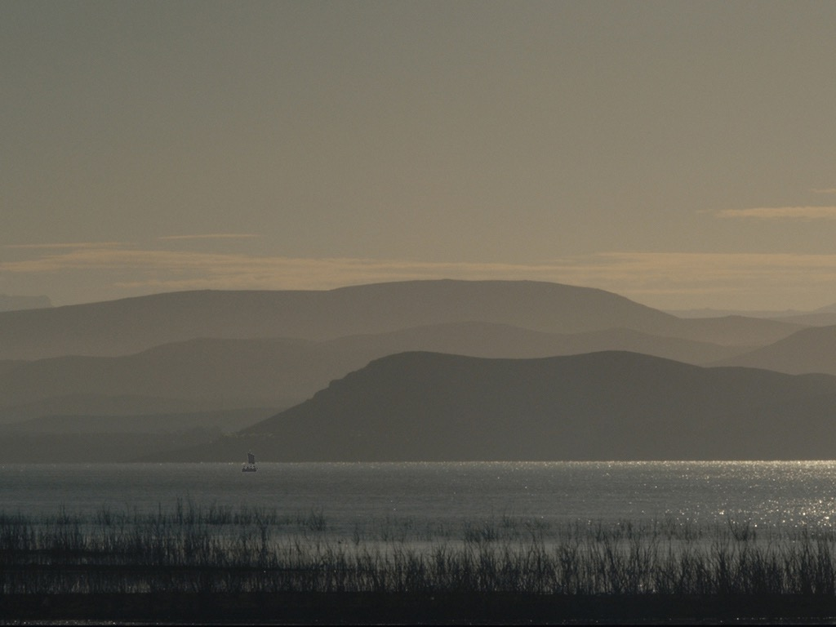
Notes:
Christ's miracles showed him as Messiah despite his opposition from the Jewish leadership (4:35–5:43).

Slide 49
Slides on Mark 6

Slide 50
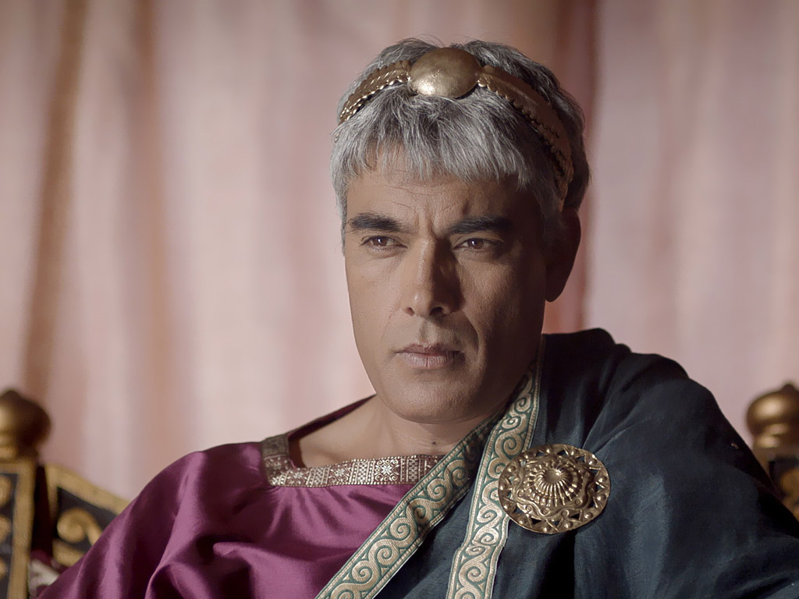
Jesus was opposed by Herod but validated his person through three miracles (Mark 6:14-56).
Notes:
Jesus was opposed by Herod but validated his person through three miracles (6:14-56).

Slide 51
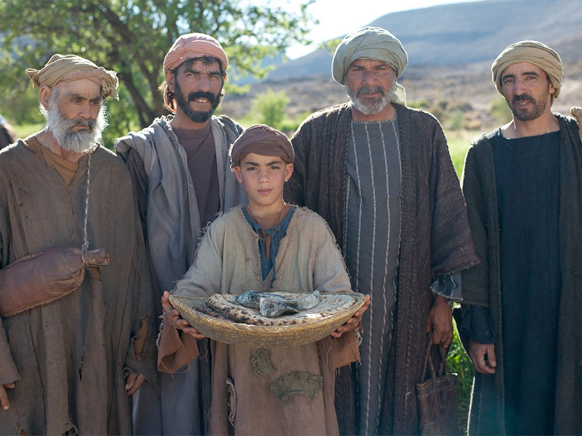
JESUS FEEDS 5000
Free Bible images
Matthew 14:13-22
Mark 6:31-46
Luke 9:10-17
John 6:1-13

Slide 52
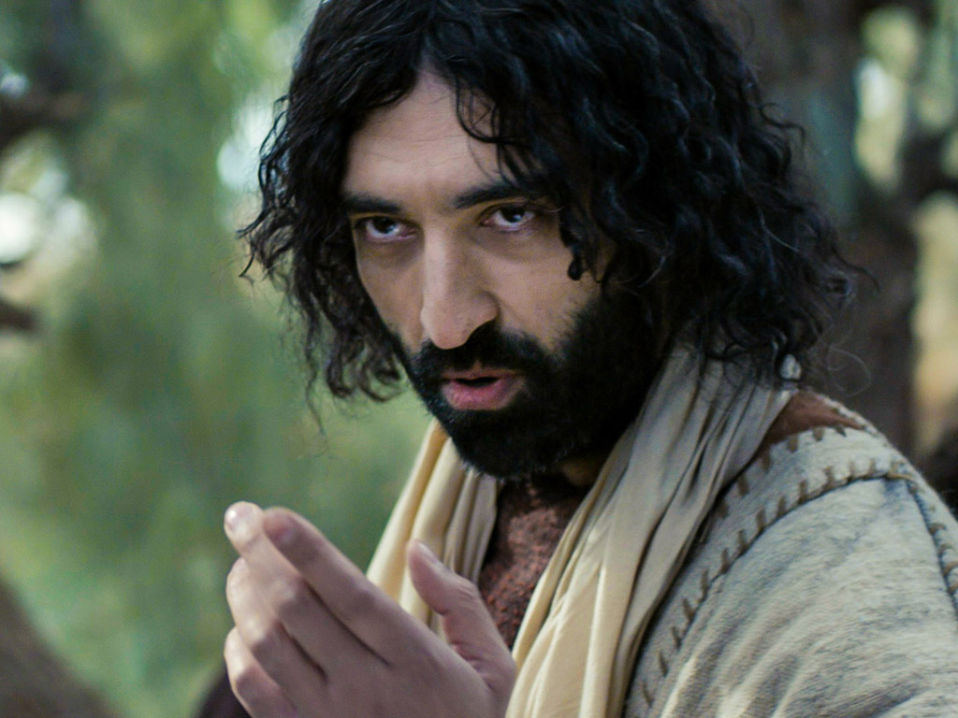
Jesus taught en route to Jerusalem that his disciples will be resisted (8:27–10:52).

Slide 53
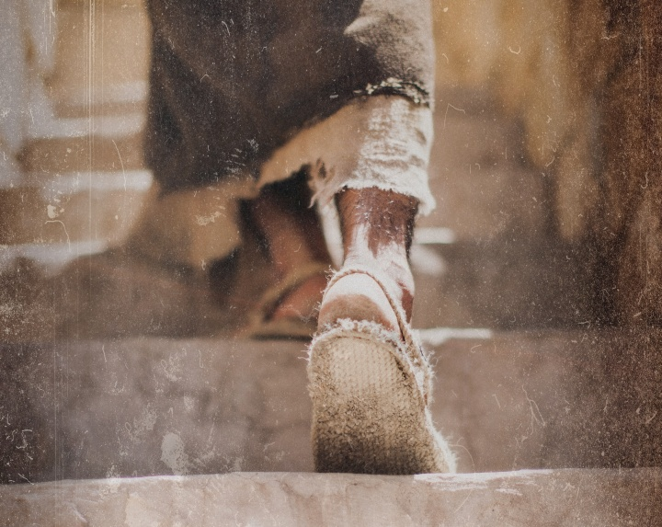
Do you resist the flow to serve Jesus more than anyone?

Slide 54
How can you be a true disciple of Jesus in a hostile world?
Notes:
What’s it gonna take to really follow Christ when most people around you oppose Jesus?

Slide 55
How to Be a Disciple in a Hostile World
Don’t cling to your Authority
Serve
like Jesus
Suffer like Jesus
1:1-13 | 1:14–10:52 | 11–15 | 16
Mark
Notes:
Mimic the self-sacrifice Jesus as Servant in his rejection and death (Mark 11–15).

Slide 56
Slides on Mark 11

Slide 57
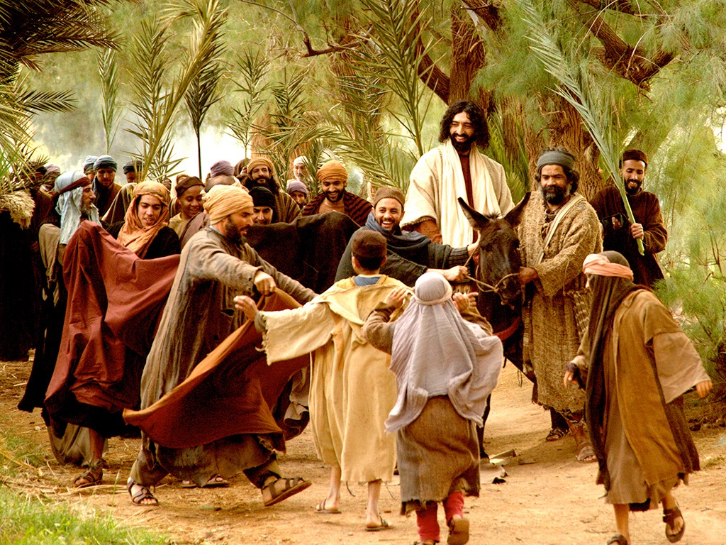
Matthew 21:1-11
Mark 11:1-11
Luke 19:28-44
John 12:12-19
THE EASTER STORY
TRIUMPHAL ENTRY (Palm Sunday)

Slide 58
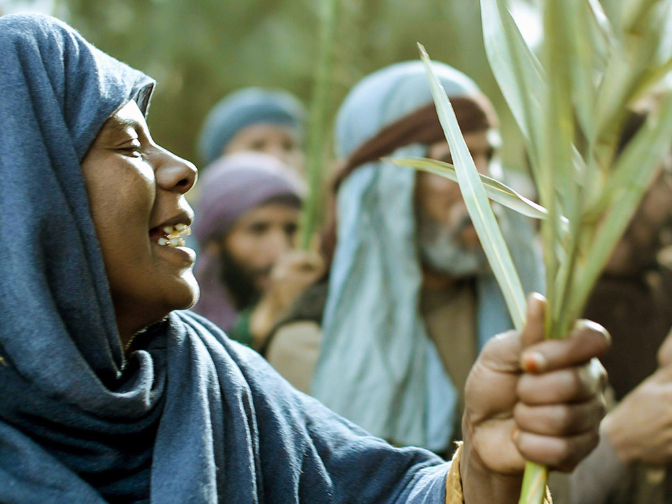

Slide 59
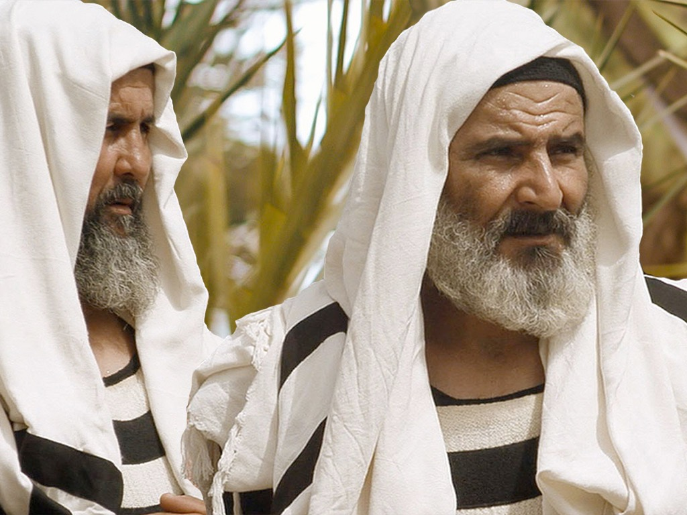

Slide 60
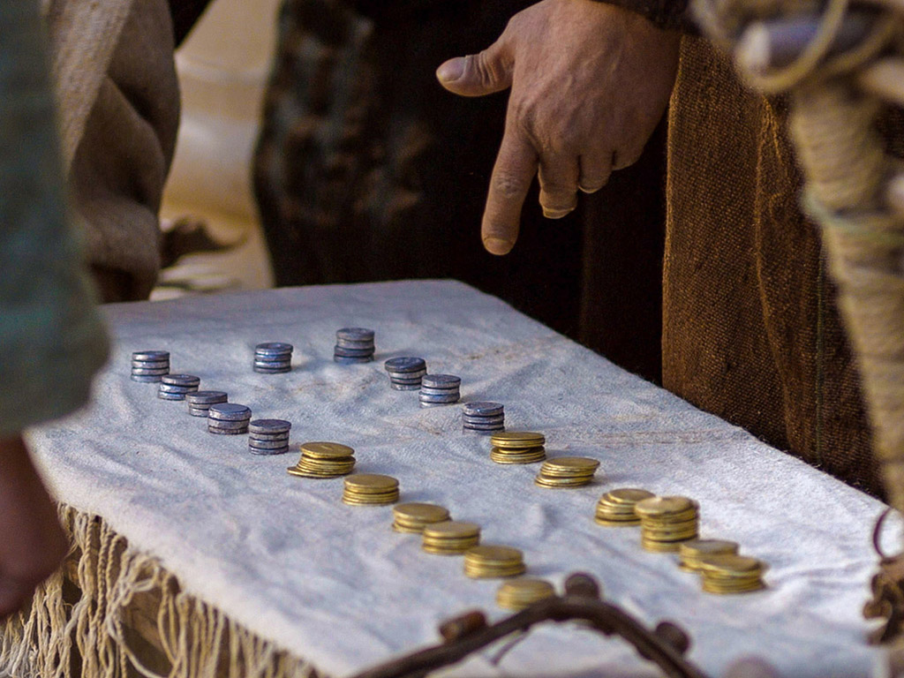

Slide 61
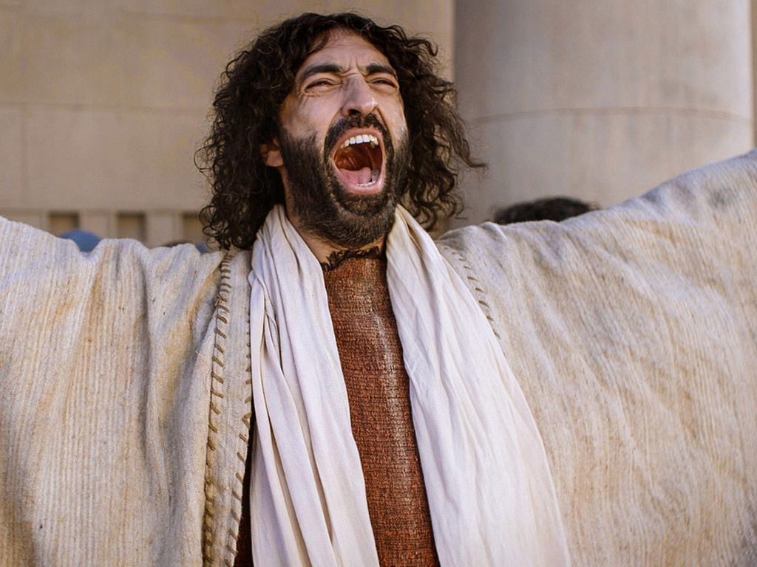

Slide 62
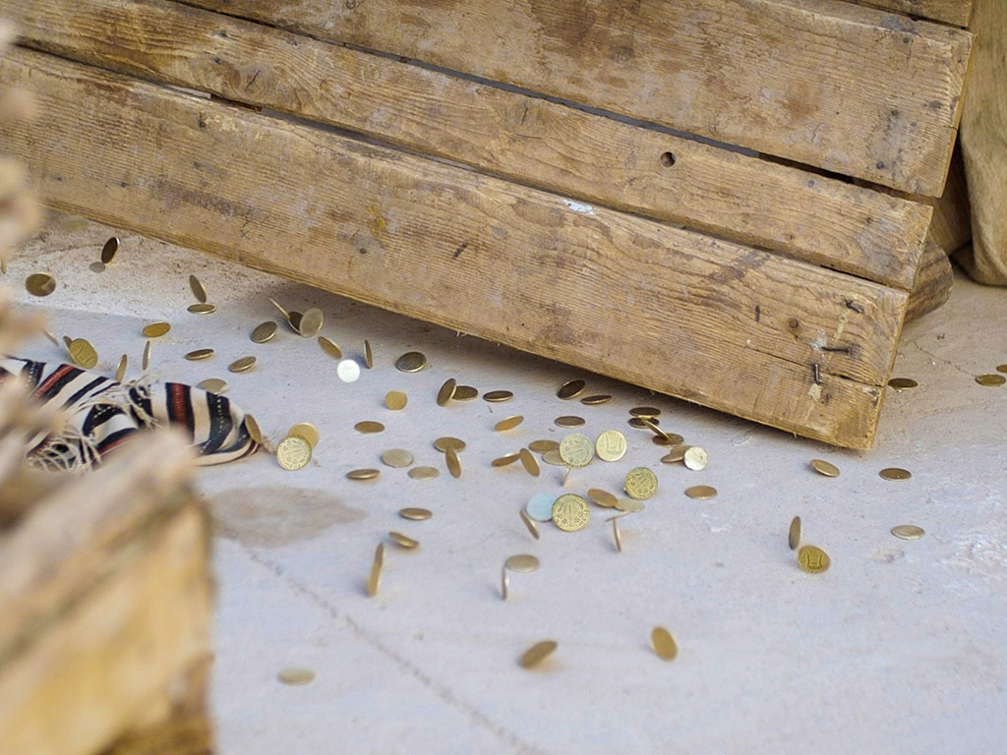

Slide 63
Slides on Mark 14

Slide 64
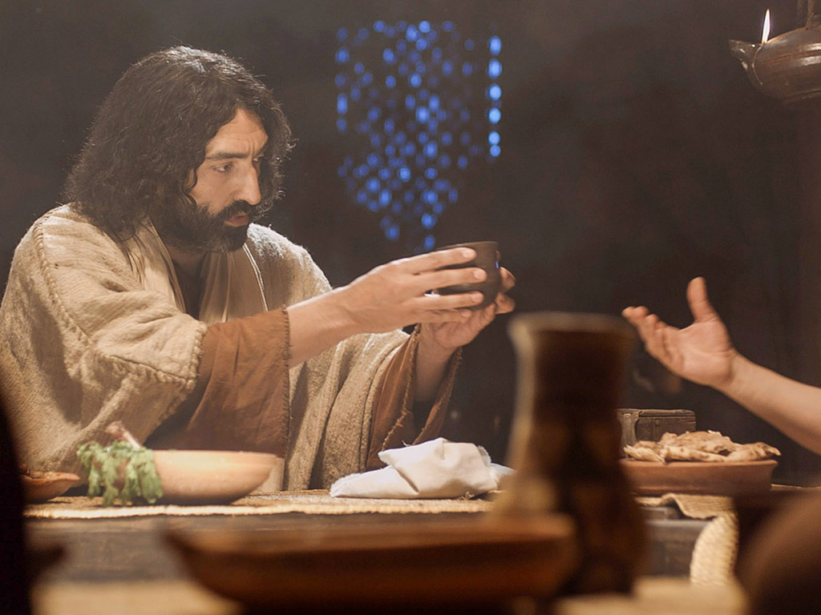
Free Bible images
Matthew 26:17-35
Mark 14:12-31
Luke 22:7-38
John 13:18-38
THE EASTER STORY
THE LAST SUPPER

Slide 65
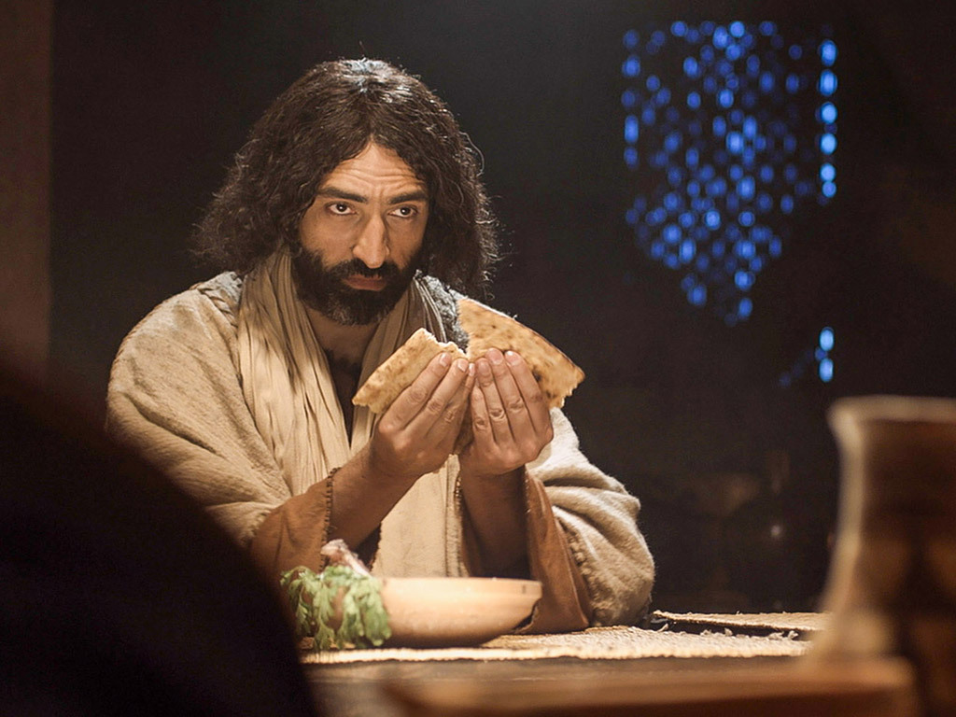

Slide 66
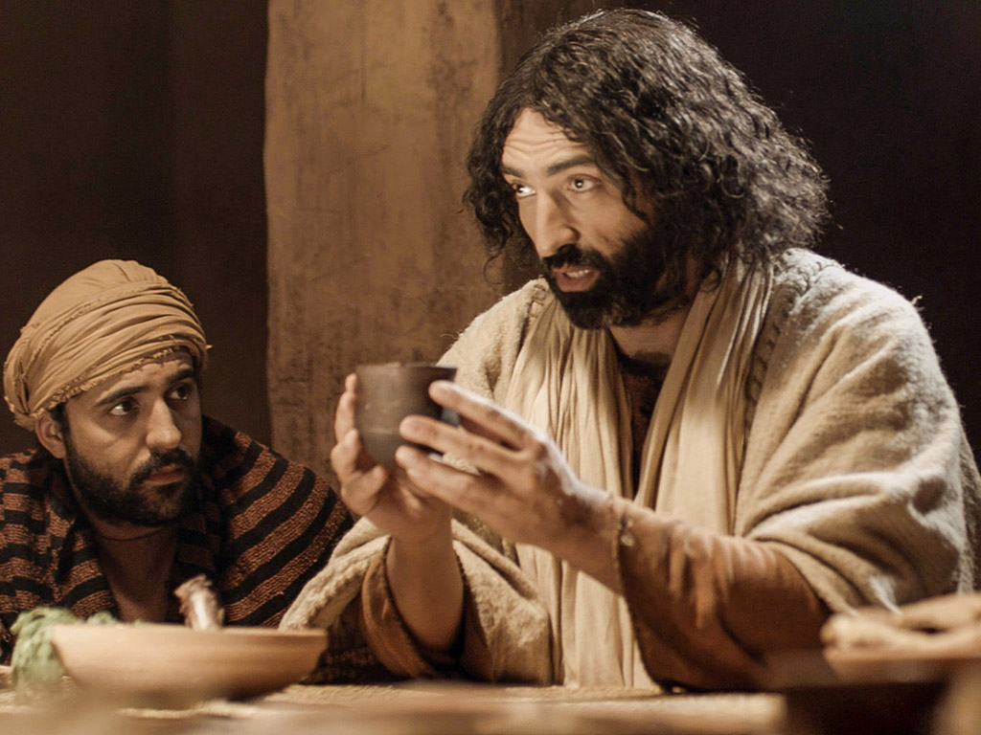

Slide 67
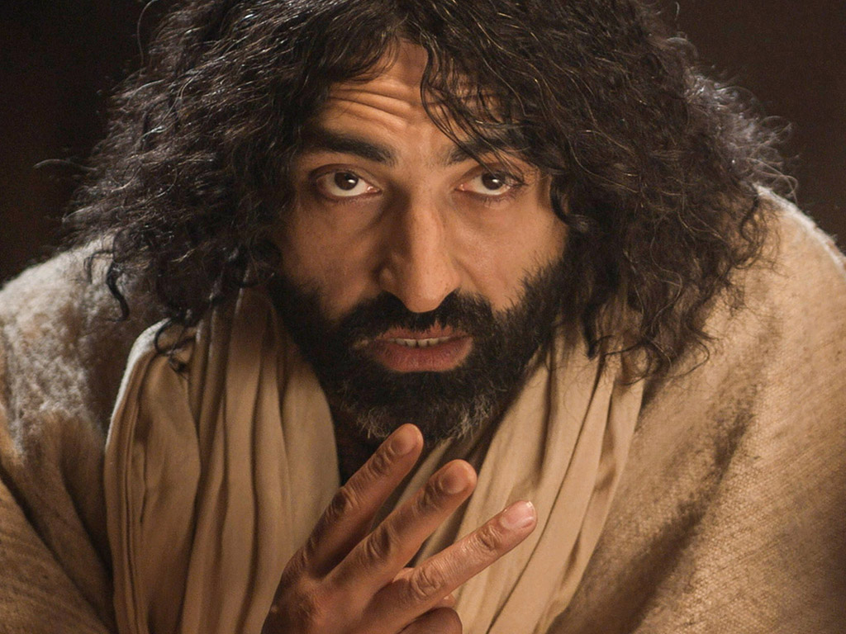

Slide 68
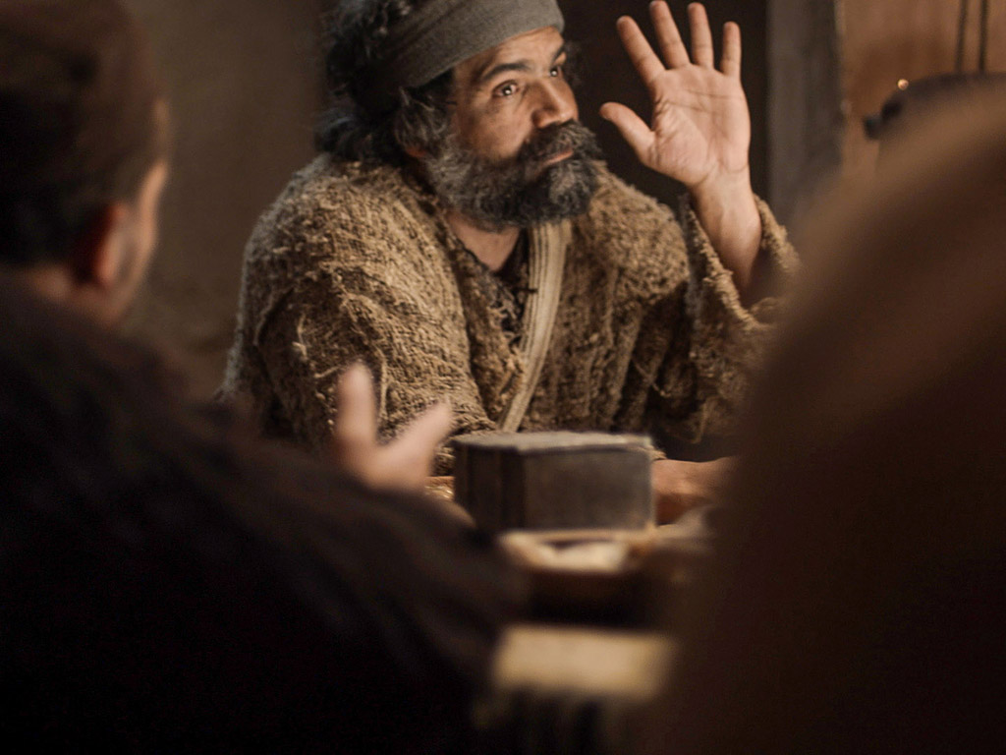

Slide 69
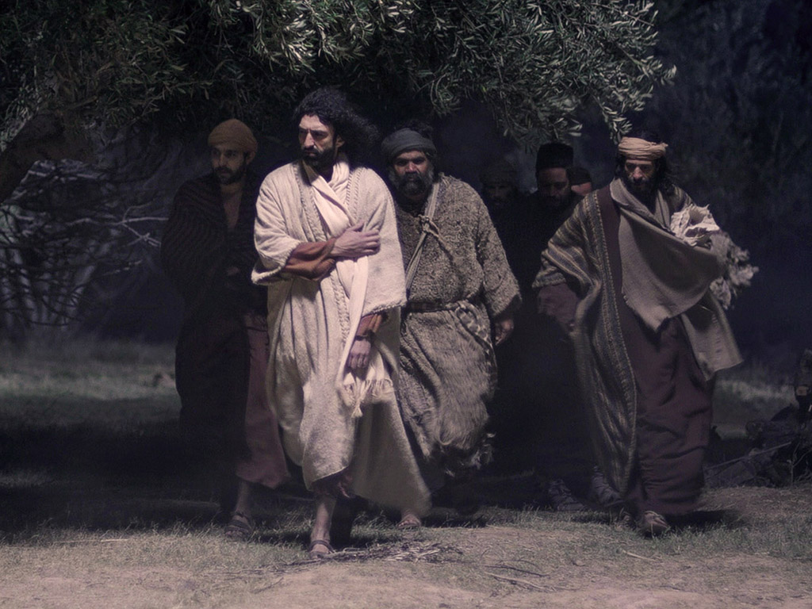

Slide 70
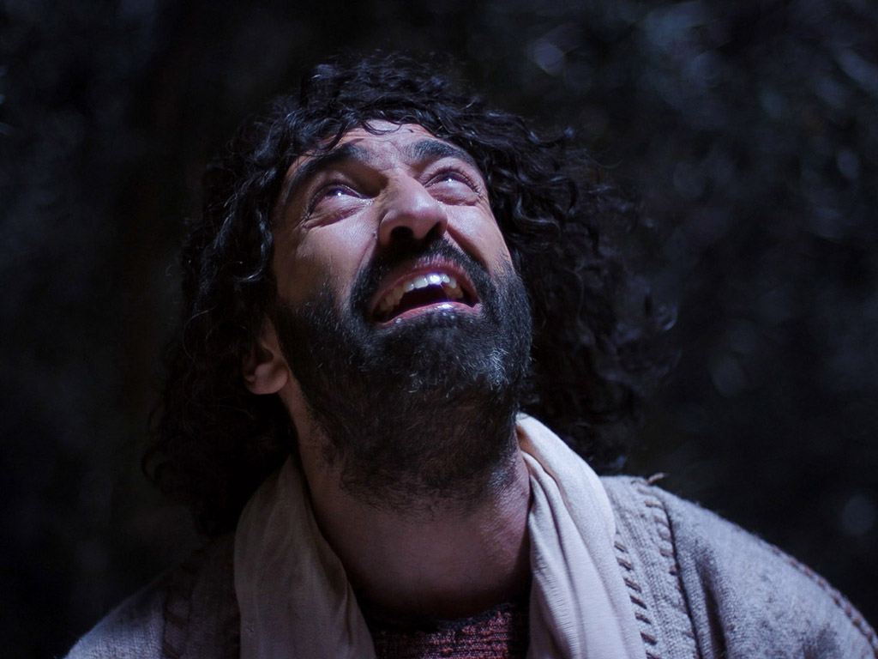

Slide 71
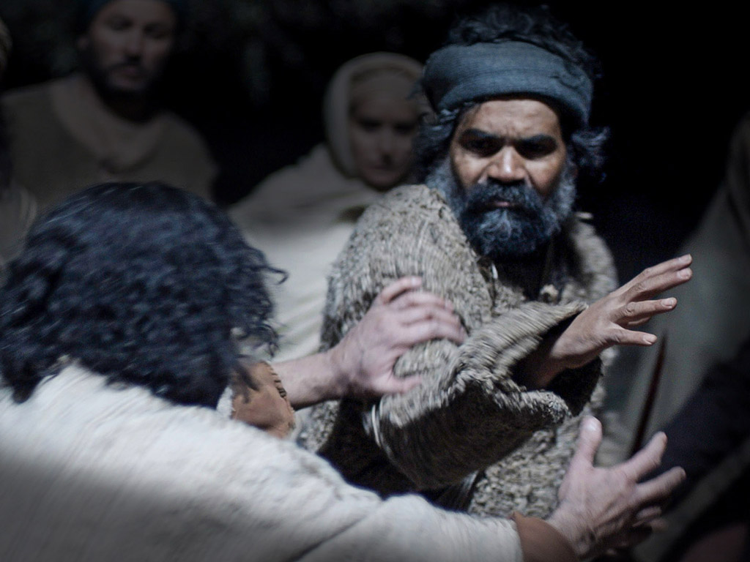

Slide 72
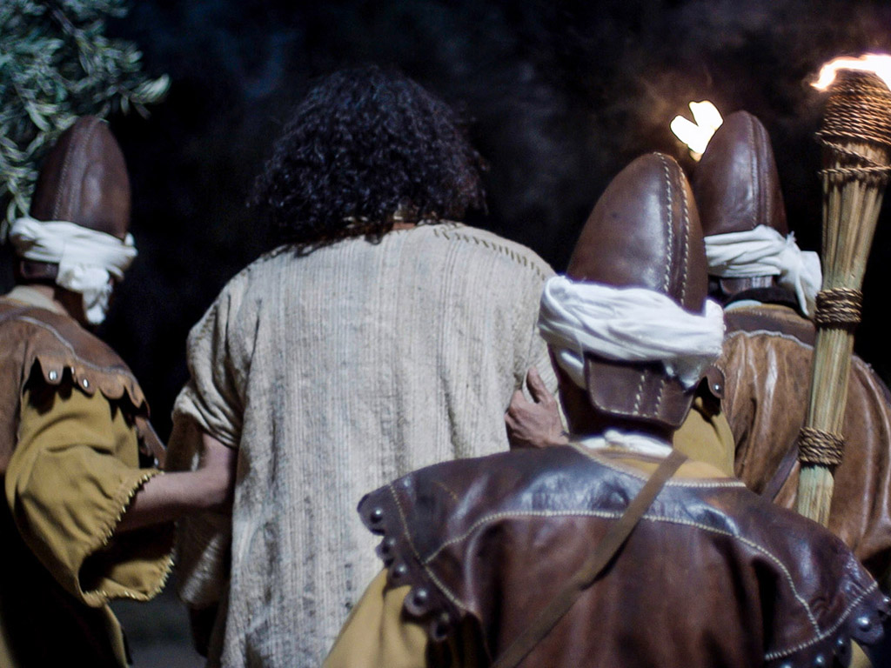

Slide 73
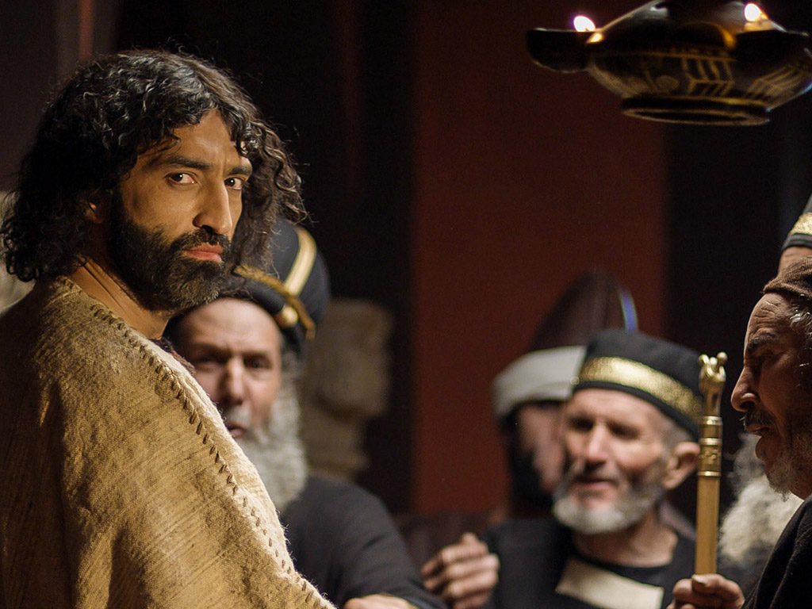

Slide 74
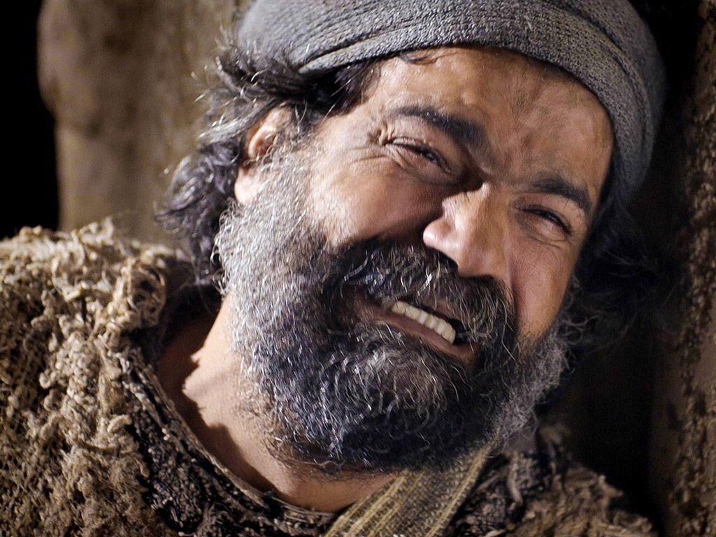

Slide 75
Free Bible images
Matthew 26:57-67
Mark 14:53-65
Luke 22:66-71
John 18:15-27
THE EASTER STORY
JESUS BEFORE THE SANHEDRIN

Slide 77
Slides on Mark 15

Slide 85
How can you be faithful despite inconvenience and suffering?

Slide 86
How can you be a true disciple of Jesus in a hostile world?
Notes:
What’s it gonna take to really follow Christ when most people around you oppose Jesus?

Slide 87
How to Be a Disciple in a Hostile World
Don’t cling to your Authority
Serve like Jesus
Suffer
like Jesus
You will Rise
1:1-13 | 1:14–10:52 | 11–15 | 16
Mark
Notes:
We will experience victory over death just as Jesus rose from the dead as Messiah and God (Mark 16).

Slide 88
Slides on Mark 16

Slide 93
Live in light of your eternal future!

Slide 94
How can you be a true disciple of Jesus in a hostile world?
Notes:
What’s it gonna take to really follow Christ when most people around you oppose Jesus?

Slide 95
Main Idea
Serve and suffer like Jesus.
Mark

Slide 96
How can you be a disciple who suffers after Jesus’ example?

Slide 97
Disciple in community.

Slide 98
Black

Slide 99
NT Preaching • BibleStudyDownloads.org
Get this presentation and script for free!

